Slide 1
Business Environment

Slide 2
Business & its Environment
Module: 1

Slide 3
Business
Business is a generic term which comprises of all primary and ancillary activities which are involved in the production and distribution of goods and services.
The term business has varied interpretations. For a consumer, business is supply of goods and services required for daily life. For the government , business is an important source of revenue. For environmentalist business is responsible for pollution.
Basically all socially desired economic activities adopted to earn profit can be defined as ‘Business’.

Slide 4
Definition
The activities of buying and selling goods, manufacturing goods or producing services in order to make profit.
Business is an institution organised and operated to provide goods and services to society under the incentive of private gains.
Business is a human activity directed towards producing or acquiring wealth thru buying and selling activities.

Slide 5
Features of Business
Dealings in Goods and Services
Production and/or Exchange
Creation of Form, Time and Place Utility
Regularity and Continuity in Dealings
Profit Motive
Risk and Uncertainty involved
Creative and Dynamic
Government Control

Slide 6
1. Dealings in Goods and Services
Goods produced or exchanged, may be consumers' goods, such as bread, rice, cloth, etc. or producers' goods such as machines, tools, etc.
The consumer goods are meant for direct consumption, either immediately, or after undergoing some processes,.
The producers' goods are meant for being used for the purposes of further production. Producers’ goods are also known as capital goods.
Services include supply of electricity, gas, water finance, insurance, transportation, warehousing, etc.

Slide 7
2. Production and/or Exchange
Every business is concerned with production and exchange of goods and services for value (money).
Thus, goods produced or purchased for personal consumption or for presenting to others as gifts do not constitute business, because there is no sale or transfer for value.
For example, if a person cooks at home for personal consumption, it is not business activity. But, if he cooks for others in his 'dhaba', or restaurant and receives payment from them, it becomes his business.

Slide 8
3. Creation of form, time and place utility
All business activities create utilities for the society.
Form utility is created, when raw materials are converted into finished goods and services.
Place utility is created, when goods are transported from the place of production to the place of consumption.
Storage of goods creates Time utility, this helps in preserving the goods, when not required and making them available, when demanded by the consumers.

Slide 9
4. Regularity and Continuity in Dealings
Regularity of economic transactions is the essence of business.
There should be continuity, or regularity of exchange of goods and services for money.
An isolated transaction cannot be called a business.
For example, if a person sells his flat and earns some profits, it cannot be called a business. But, if he purchases and sells flats regularly to earn his livelihood, it will be called his business.

Slide 10
5. Profit Motive
The chief objective of a business is to earn reasonable profits or 'surplus'.
The survival of a business depends upon its ability to earn profits.
Every businessman wants to earn profits, to get return on his capital and to reward himself for his services.
Actually, profit is the spur that helps in the continuation of the business.
Profit is also essential for growth.
Recreation clubs and religious institutions cannot be called business enterprises, as they have nothing to do with the profit motive.

Slide 11
6. Risk and Uncertainty involved
Business activities are always risky and uncertain.
Every businessmen has to undertake substantial risks in his business.
A business enterprise may suffer loss due to a number of possible reasons such as changes in technologies, changes in consumer tastes and preferences, market competitions etc.

Slide 12
7. Government Control
Government has to keep a watch on overall business activities and see that they move in the right direction.
For this , government control is a must.
This may be in the form of suitable laws, rules, regulations, sanctions and so on.

Slide 13
8. Creative & Dynamic
Business activities are creative as they are normally for the convenience of consumers. They are ever changing.
This is natural as business operates under changing economic, social, and technological environment.
Modern business is dynamic as it has to change and adjust its activities as per the environmental factors.

Slide 14
Need / Function of Business
Regular supply of goods and services
Optimum & meaningful use of resources
Creation of employment opportunities
Provision of revenue to the government
Social welfare
Facilities economics growth
Capital Formation

Slide 15
Types of Business
Sole Trading Concern
Partnership Firm
Joint Stock Company
Cooperative Society
Joint Hindu Family Business

Slide 16
BUSINESS OBJECTIVES

Slide 17
WHAT ARE BUSINESS OBJECTIVES?
Every rational human activity needs well defined objectives. Business is no exception to this rule.
Profit making, social recognition and business growth are some universally accepted Business objectives .
Objectives indicate the destination towards which the business unit desires to move.
Running a business unit without well defined objectives is like journey without fixed destination.
On the other hand objectives means giving a definite and clear direction to the activities of the organisation.

Slide 18
Objectives are the ends which a business unit desires to achieve. They are future destinations of an organisation. They act as focal points before the business enterprise.
Objectives are normally decided by the top management of the company. Lower level are too busy in routine business activities and do not have time to look after overall business objectives.
Top management should review the objectives periodically and give proper direction to the whole organisation in this regards.
Objectives are not stable over a long period. In fact they are redefined periodically as per the environmental changes.

Slide 19
Definitions of Business Objectives
Objectives are the ends towards which activities of any enterprise or department or project within it are aimed.
Objectives are the goals, aims or purpose that organisations wish to achieve over varying period of time.
A specific result that an organisation aims to achieve within a time frame and with available resources.

Slide 20
Examples of Business Objectives
Increase your product or service's market share
Reduce employee turnover and increase satisfaction
Maintain or increase profits
Strengthen customer service
Install tools and systems to increase productivity
Improve company value
Enhance the quality of a business's product or service
Reduce Ongoing Business Expenses

Slide 21
Features/Characteristics of Business Objectives
Lengthy Process
Clear and easily understandable
Concrete and Specific
Challenging
Time Frame
Profitability
Flexible
Hierarchy of Objectives
Qualitative and Quantitative

Slide 22
Importance/Significance of Objectives in Business Management
Objectives justify the existence :
Every enterprise needs its own objectives. The objectives offer social justification for its existence. A business enterprise lacks moral right to operate if there is nothing to achieve.
Facilitates planning process :
Business objectives facilitates management process which includes planning, organising, staffing etc. Management which does not define its objectives would not know where it wants to go and will become a victim of confusion. Objectives facilitates planning process.

Slide 23
Define relationship with its environment :
Objectives suggest what the organisation desires to achieve for its employees, customers and the society at large under the prevailing circumstances. Well defined objectives give convenience to the organisation and the outsiders also.
Enable managers to work with confidence :
Objectives guide and motivate managers and thereby enable them to manage business activities with confidence. Managers set the objectives for them and also for the organisation and see that they are achieved within the fixed time limit.

Slide 24
Facilitates correct Decision making :
Objectives help to coordinate strategic decision making in the organisation. Decision making process becomes easy, quick and correct in the light of the objectives.
Provides standard for performance appraisal :
Objectives state the targets to be achieved within a specific time limit. They can be used by judging actual performance. Objectives provide clear cut basis for evaluating the performance of an organisation.

Slide 25
Brings uniformity in the activities of departments :
Objectives act as connecting link and bring integration in the activities of different departments such as production, sales, finance etc. Broad objectives are divided into smaller parts and made applicable to different departments. This ensures coordination and uniformity in the working of different departments.

Slide 26
Organic/ Threefold /Basic Objectives of Business

Slide 27
Organic/ Threefold /Basic Objectives of Business
A business unit has to give attention to 3 basic objectives.
Survival
Growth
Recognition/image

Slide 28
Survival
Survival in the business is the basic objective of a business unit.
It is classified as organic/primary objective of business.
Survival comes first and profit comes next.
Other objectives can be thought of only if the business unit stands independently in the market.
No company can take its survival for granted in the present complex and highly competitive business environment.
Constant monitoring of the business situation and strategic planning are necessary for survival in the competitive business environment.
For survival, full utilization of available resources, adjustment with the environmental forces, enhancing competitive capacity and securing support of various social groups are necessary.
Profit And Survival are supplementary, as survival in business is just not possible without earning profits.

Slide 29
Growth
Growth is the second major business objective. It is next to survival as a business unit can go for expansion only when it gets adequate stability.
Growth means expansion of business activities by introducing new products, new plants, expansion of marketing activities, diversification in new areas, foreign collaboration, takeovers etc.
A business unit can have expansion only when its survival base is sound. Survival is essential for growth.
Expansion and growth bring more profit, more business and popularity to a business unit.
Long term planning is necessary for orderly and multi dimensional growth of an enterprise.

Slide 30
Recognition /Image/ Prestige
A business unit desires to have social recognition i.e. market reputation. This objective can be described as favourable image building of the enterprise among consumers and other social groups.
After securing stable survival and growth an enterprise will like to give attention to image building and market standing.
This can be done by sponsoring sports, cultural activities, educational project and so on.
The basic purpose is to have a good public image.
The enteprise feels that others should have confidence on the company and treat it as an honest and consumer friendly company.
Prestige generally comes due to standard quality of its products, regularity in their supply, reasonable prices and satisfactory service to consumers.
Recognition indicates public confidence on an enterprise. Such recognition is only possible after a long period of useful service to the society.

Slide 31
Steps in formulating Business Objectives

Slide 32
Consider Environmental Factors
Consider resources of the enterprises
Consider individual dominance
Consider value system
Consider past objectives
Determine final objectives

Slide 33
Business Environment

Slide 34
Environment
The word Environment is derived from the French word “Environ” which means “surrounding”.
Environment means the surrounding within which someone or something exists.
It is like the climate or culture which surrounds us.
Man and his environment are closely connected and related.

Slide 35
Business Environment
A business organisation does not exist in a vacuum.
It is in fact dependent on the environment.
For efficient and rational decision making a business organisation must understand its relationship with its environment.
Business has to operate within the situation created by the environmental factors/forces. It has to adjust its activities as per the environmental changes.
Such adjustability is essential for survival and growth of business.

Slide 36
A business firm is an open system and it affects and is affected by outside events and factors which make up the external environment.
Business environment may offer opportunities for the firm or threats to the firm.
A business firm is also affected by a number of internal factors, which are forces inside the business organisation.
While the policy makers and the managers at the top level are concerned with the external environment, the middle level and lower level management are more concerned with the internal environment.

Slide 37
Definition
The combination of internal and external factors that influence a company's operating situation.
The total of all things external to firms and individuals, which affect their organisation and operations.
The aggregate of all conditions, events and influences that surround and affect it.

Slide 38
Features of Business Environment
Environment is the surrounding situation of business
Environment is dynamic
Business to a greater extent can not control the environment
Business can not directly change the external environment
Direct and lasting effect
Environment is inseparable part of business
Business environment is complex
Environment creates opportunities and challenges

Slide 39
Components / Types/ Areas of Business Environment

Slide 40
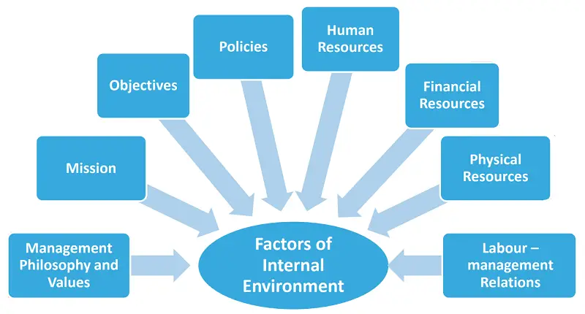
Internal Environment
Value system
Mission and Objectives
Corporate Image
R and D Facility
Human Resources
Organisations physical and financial resources

Slide 41
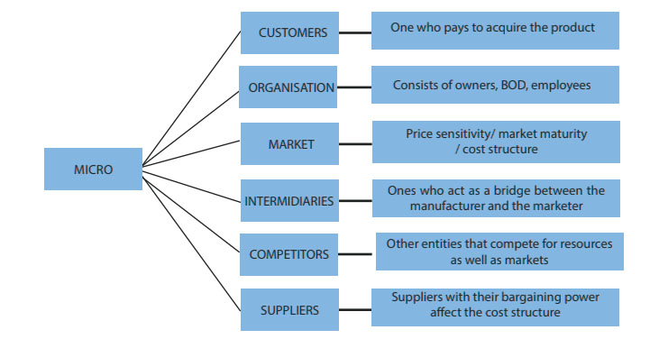
External Environment

Slide 42
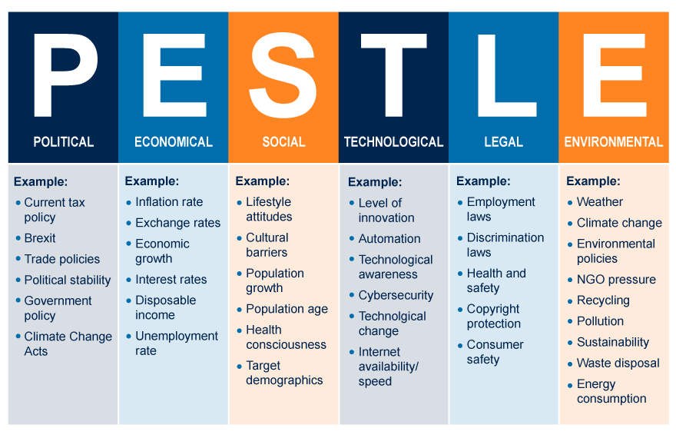
Macro Environment

Slide 43
External Environment
Micro Environment
Macro Environment

Slide 44
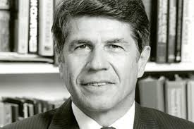
External Environment
PESTLE ANALYSIS
P - Political Environment
E – Economic Environment
S - Socio Cultural Environment
T - Technological Environment
L - Legal Environment
E - Ecological Environment
PESTLE Analysis was created by Harvard Professor, Francis Aguilar in 1967.

Slide 45
1. Political Environment
This includes the political system, the government policies and attitude towards the business community and the unionism.
All these aspects have a bearing on the strategies adopted by the business firms.
The stability of the government also influences business and related activities to a great extent.
It sends a signal of strength, confidence to various interest groups and investors.
Further, ideology of the political party also influences the business organisation and its operations

Slide 46
Elections, assurances given by political parties, donations to political parties, political developments like death of an important political leader, political scandals, corruption charges on leading political parties, war etc are major political factors which affect the political environment.
The success & growth of business depends upon stable, dynamic, honest, people oriented government, proper law and order situation, strong party in power, responsible opposition and responsible role of press and publicity.
Political friendship & diplomatic relations help in growth of trade.

Slide 47
Countries with stable government and political system have enjoyed successful and efficient business operations. USA is the best example.
Business and Politics is inseparable. In fact business can not remain unaffected by Politics.
Business and Politics are inseparable. Business cannot remain unaffected by politics.

Slide 48
Features
Influencing factors
Favorable or Unfavorable
Sensitive and flexible
Closely related to Economic environment
Importance of stable Political environment

Slide 49
2. Economic Environment
Economic conditions, economic policies and economic system are the factors that constitute the economic environment.
It is multi dimensional in nature & includes all factors connected with the working of the economic system.
Economic environment includes investment trends, inflation, monetary policy, fiscal policy, budgetary policies, business laws, industrial licensing, foreign exchange policies, Exim policy, labour policies, balance of trade, balance of payment, economic planning, commercial policies etc.
Economic environment is basically the net result of economic policies of the government.

Slide 50
Businessmen have to study the prevailing economic environment and adjust their business plans accordingly.
Favourable business environment bring rapid expansion of business activities including marketing, manufacturing, exporting and so on.
Economic Environment is supplementary to political environment and is influenced by political decision and political events.

Slide 51
Features of Economic Environment
Influencing factors.
Multi Dimensional in nature.
Influential role of government in shaping economic environment.
Limited influence of business on economic environment.

Slide 52
3. Socio Cultural Environment
Society includes different social groups i.e. consumers, investors, local community and employees.
The needs and expectations of these social groups create Social Environment for business.
Social Environment is supplemented by cultural environment which is the result of cultural factors as cultural values and beliefs, morals, art, customs, religion and so on.
Progressive changes takes place in cultural aspects ex festivals, music, dance etc this creates demand for new products and changes in the demand for existing ones.

Slide 53
Even changes in fashions, lifestyles, religious and cultural festivals, marriage, birth etc needs to be studied by businessmen in order to adjust business activities as per the change in the cultural environment.
Thus these social norms have the influence on business activities. This is natural as business needs social support for its survival and growth.
For example, during festive seasons there is an increase in the demand for new clothes, sweets, fruits, flower, etc.
Nestle brews a very large variety of instant coffee to satisfy different national tastes. Even when people of different cultures use the same product.
Color : Blue : feminine and warm in Holland , but masculine and cold in Sweden.

Slide 54
Features
Influencing factors.
Dynamic nature.
Special significance.
Growing strength of consumerism
Importance of adjustment.

Slide 55
4. Demographic Environment
This refers to the age, sex, family size, density, distribution , standard of living and growth rate of population. All these factors have a direct bearing on the demand for various goods and services.
For example a country where population rate is high and children constitute a large section of population, then there is more demand for baby products.
Similarly the demand of the people of cities and towns are different than the people of rural areas.
The high rise of population indicates the easy availability of labour. These encourage the business enterprises to use labour intensive techniques of production.

Slide 56
Moreover, availability of skill labour in certain areas motivates the firms to set up their units in such area. For example, the business units from America, Canada, Australia, Germany, UK, are coming to India due to easy availability of skilled manpower.
Thus, a firm that keeps a watch on the changes on the demographic front and reads them accurately will find opportunities knocking at its doorsteps.
Decline in birth rates in Japan have affected the demand for baby products. So Johnson &Johnson repositioned their baby products like baby shampoo and baby oil to the Adult segment particularly to females.

Slide 57
Features
Influencing factors.
Effects on labour supply
Creates Opportunities and problems.
Adjustment with demographic environment is essential

Slide 58
5. Natural/Physical/Ecological Environment
The natural environment includes geographical and ecological factors that influence the business operations.
These factors include the availability of natural resources, weather
and climatic condition, location aspect, topographical factors, rainfall, minerals, soils, land forms, flora and fauna etc.
Business is greatly influenced by the nature of natural environment. For example, sugar factories are set up only at those places where sugarcane can be grown.
It is always considered better to establish manufacturing unit near the sources of input.
In hilly areas with difficult terrain, jeeps may be in greater demand than cars.
Further, government’s policies to maintain ecological balance, conservation of natural resources etc. put additional responsibility on business sector.

Slide 59
Features
Influencing Factor.
Imposes restrictions.
Importance of pollutions control.

Slide 60
6. Technological Environment
Technological environment include the methods, techniques and approaches adopted for production of goods and services and its distribution.
The varying technological environments of different countries affect the designing of products.
In the modern competitive age, the pace of technological changes is very fast.
Hence, in order to survive and grow in the market, a business has to adopt the technological changes from time to time.

Slide 61
It may be noted that scientific research for improvement and innovation in products and services is a regular activity in most of the big industrial organizations.
Now a days in fact, no firm can afford to persist with the outdated technologies. It becomes necessary to use the new technology in place of old. Ex : Telephone is replaced by mobile phones, DVDs by Pen Drive and camera by Cell phone cameras.
Business prospects demands availability of certain physical facilities. For Ex: demand for electrical appliances is affected by the extend for electrification and the reliability of power supply. Demand for LPG stoves depends on rate of growth of gas connections.

Slide 62
Features
Influencing factors.
Growing significance.
Role of R&D
Flexible character.

Slide 63
7. Regulatory (Legal) Environment.
This refers to set of laws, regulations, which influence the business organisations and their operations.
It creates a framework of regulations and legal provisions within which the business units have to operate.
What business can and what business cannot do are decided by regulatory environment.
Thus it is the net result of various laws, rules, procedures and regulations made by the government from time to time in regard to the formation and operations of business enterprises.

Slide 64
The important legislations that concern the business enterprises include:
Companies Act, 1956
Foreign Exchange Management Act, 1999
The Factories Act, 1948
Industrial Disputes Act, 1972
Payment of Gratuity Act, 1972
Prevention of Food Adulteration Act, 1954
Essential Commodities Act, 2002
The Standards of Weights and Measures Act, 1956
Monopolies and Restrictive Trade Practices Act, 1969
Trade Marks Act, 1999
Consumer Protection Act, 1986
Environment Protection Act, 1986
Competition Act, 2002

Slide 65
Features
Influencing factors.
Creates legal framework.
Laws and regulations create Regulatory Environment.
Provides protection to ecology.

Slide 66
Difference between Micro & Macro Environment

Slide 67
Limitations
Does not foretell the future
Does not guarantee a firm’s effectiveness
Capacity of environment study is not realized
Too much importance is placed on information thru environment study
Makes managers too cautious

Slide 68
SWOT Analysis

Slide 69
Positive
Negative
Strengths
Excellent R & D facilities
Supremacy of improved technology
High Brand Equity
Best Talent at Work
Strong Financial Position
Weakness
Low Productivity
Narrow Product Range
Poor capital Structure
High Employee Turnover
Ineffective Sales Promotion
Internal
Opportunities
Attractive Overseas Markets
Business friendly Tax System
Diminished Competition
Booming Stock Market
New Uses of the Product
Threats
Political Instability
Strict Government Controls
Entry of Global Giants
Union Military
Fluctuations in foreign exchange rates
External

Slide 70
SWOT analysis is a fundamental step in business environment.
It is a systematic approach to understand the environment influencing business.
SWOT analysis stands for Strength, Weakness, Opportunities and Threats.
This analysis provides a systematic insight into the internal strengths and weaknesses of a business firm along with external opportunities and threats.
It provides a good overview of whether the overall system is healthy or unhealthy.

Slide 71
Definition
It is a simple but powerful tool for sizing up a company's resource capabilities and deficiencies its market opportunities and the external threats to its future well being.
Situation Analysis in which internal strengths and weaknesses of an organization, and external opportunities and threats faced by it are closely examined to chart a strategy.

Slide 72
Strengths
Strengths are something a company is good at doing and improves its ability to compete.
They are internal to business and they are controllable premises.
It enables the company to gain strategic advantage.
It helps a company to better its performance than its competitors.

Slide 73
Patents
Strong brand name
Good reputation amongst the customers
Cost advantages
Exclusive excess to high grade natural resources
Support from distributive network
Broad product line
Committed employees

Slide 74
Weaknesses
They are the competitive deficiency.
It is something a company falls short of, in comparison to its competitors.
It is internal to the business and is a controllable premises. Weaknesses decreases the competencies of the company and create strategic disadvantages.
It is the inability of the company to perform certain activities not as good as its competitors.

Slide 75
Lack of patent protection
Weak brand name
Poor reputation among the customers
High cost structure
Lack of access to high grade natural resources
Lack of access to key distribution channels
High employee turnover
Huge debts
Waste of raw materials

Slide 76
Opportunities
They are external to business. They are passing phase.
If a business does not take advantage of it, the competitors snatch away the benefits.
It is an uncontrollable premises.
Favorable opportunities enable a company to consolidate and strengthen its position.

Slide 77
An unfulfilled customer needs
Arrival of new technology
Favourable changes in regulations
Removal of trade barriers
Availability of easy bank loan
Tax holidays
Limited competition

Slide 78
Threats
They are external to business.
There is hardly any protection against threats.
It is an unfavorable condition in the organisations environment.
A company that is not competent to handle risks faces threats.
Managers can visualize that a threat exists but there is very little one can do to save the business from the threats.

Slide 79
Change in consumer behavior
Emergence of substitute product
New stringent regulations
Imposition of trade barriers
Unethical competitors
Aggressive trade unions

Slide 80
Advantages of SWOT Analysis
Capitalize on Strengths
Win over Weaknesses
Benefit from Opportunities
Correct visualization of threats
Improvement of business
Future oriented
Provides alternative choices

Slide 81
Conduct a SWOT of any Company of your choice

Slide 82
THANK YOU

